Slide 1

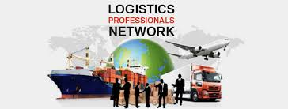
International Transportation Trade Program
Freight Logistics Professional workshop 2018
By
Shankar Subramoniam
Executive Director - NAFL UAE
MCOM ,MBA , FICS, CMILIT , Six sigma, IATA DGR, FIATA , HACCP , Leadership

Slide 2


Introduce Yourself
What is your Name
Area of work you are doing in the work place –e.g. sales operation , documentation
What is biggest challenge you face
What you would have done if your are not in this Industry
What is your passion
What is expectation from this workshop

Slide 3



Skills Required In Freight &Logistics

Slide 4

Agenda
FOREWORD:
NAFL International Freight Forwarding Programs
  Career Enhancements
  Schedule & Tips on Success
INTRODUCTION:
  NAFL – its history, mission and structure
  FIATA- its objectives, structure and activities
  Freight Forwarder: Code of Ethics and Standard Trading Conditions

Slide 5

Agenda
UNDERSTANDING FREIGHT FORWARDING
  Defining the Freight Forwarder
  Designing Global Solutions: The Architect of Transport
  Overview of International Trade
  Corporate courses offered by NAFL
  Education Tour to Dubai – port /3pl facility / Industry visit .

Slide 6

INTRODUCTION
NAFL is a Member of FIATA
FIATA is the acronym for the French name of the parent organization of national freight forwarding associations (Federation Internationale des Associations de Transitaires et Assimiles).

Slide 7
How Do I Succeed?
E-Learning
  Read Textbook
    Lecture (hit the highlights)
      In class workshops
        Workbook
          Relate case studies
            Testing

Slide 8
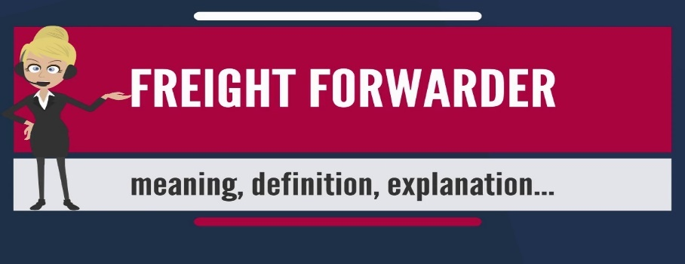
WHAT IS THE FREIGHT FORWARDER'S DUTY?
2. CONDUCT
Members act professionally
Not intentionally to mislead the public
Provide shall be accurate information
Notes:
2. CONDUCT
At all times within the law, Members shall act professionally and in the interest of their clients, subject to their own proper and reasonable commercial considerations and undertake to provide confidential and competent services and otherwise.
Members undertake not intentionally to mislead the public.
In their dealing with third parties in the performance of their service to clients, Members undertake that any information they provide shall be accurate so far as it is known to them.

Slide 9
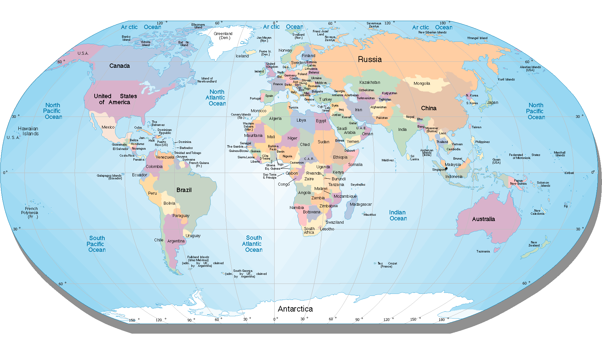
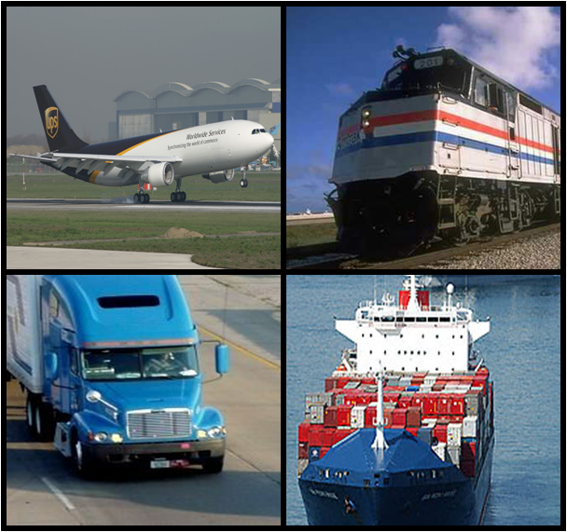
  Understanding Freight Forwarding
Freight forwarding is all about the smooth flow of international trade

Slide 10
Understanding Freight Forwarding
Individual:
  Trained
  Experienced
  Provides solutions to customers
Organization:
  Invests in IT solutions
  Invests in professional, knowledgeable employees
  Traditionally, non-asset based …. Today ….
Division of large, multi-national organization: total end-to-end solutions/”order to cash” solutions
Small or medium sized company: specialize in one aspect

Slide 11
Understanding Freight Forwarding
A freight forwarder ensures the goods arrive:
  At the right place
  At the right time
  In good order and condition; and
  At the most economic cost
Across geographic boundaries
Across political boundaries
Across cultural boundaries

Slide 12

Architects of Transportation
International maritime law, cargo insurance ,customs , cargo security, international trade – the freight forwarder designs and presents solutions to meet the customer’s needs.
Electrical, heating, plumbing, construction, height, construction material; picking and choosing from all available options to select the best building to meet the customer’s needs.
Notes:
If we substitute the words “freight forwarder” for “architect” we clearly see the role of the transportation intermediary in the design of international transportation solutions. Partnering with users to understand their needs and wants, with a thorough knowledge of the multitude of regulations governing the transaction – from international maritime law to cargo insurance to customs environments through all of the new cargo security legislation and a sound understanding of international trade – the freight forwarder designs and presents solutions to meet the customer’s needs
QUESTION: So, what knowledge, skills or competencies must a freight forwarder have in order to design Transportation Solutions?

Slide 13
Designing Global Solutions
Regulatory Compliance
  Cargo security, advance commercial information, export declarations, import Customs clearance
Risk Management
  Loss, damage and delay: how to mitigate risk
Finance and Payment
  From Open Account to Letter of Credit
Cross Functional Integration in Global Supply Chains
  Catalyst revolutionizing processes
Networks, Local Knowledge and CREEEPSS
  Representation at origin and at destination
Notes:
To design the best solution, the “Architect of Transport”, must understand world geography, how global supply chains work, and the barriers goods and information must cross.

Slide 14
Designing Global Solutions
CREEEPSS
Culture
Religion
Education
Economics
Environment
Politics
Social and
Special Characteristics

Slide 15



Overview of International Trade
The parties:
  The exporter
  The importer
  The freight forwarder
  The carrier
  The bank(s)
  The government(s)

Slide 16
Overview of International Trade
The Process:
Understanding the terms of sale and terms of delivery between the seller and the buyer
Choosing the right of mode and route of transport
Preparing and submitting accurate and appropriate information, completing documentation requirements

Slide 17
Overview of International Trade
Buyer and Seller: Negotiating the Sales Contract
  Terms of Payment: How and when the buyer will pay the seller
  Terms of Delivery (Incoterms): Who bears risk, responsibility and cost for shipping the goods
Forwarder and Carrier: Moving the Goods and Information
  Ocean/ air/ truck + cartage, loading , crating, consolidation, export declarations, tracking
Forwarder and Customs Broker: Customs Clearance and Delivery
  Deconsolidation, customs clearance, delivery

Slide 18
Conclusion
Designing solutions - freight forwarders offer every service involved in the:
  Physical movement of goods
  Preparation of documentation
  Transfer of required data
Notes:
As they design solutions to meet the needs of customers around the world, freight forwarders offer every service involved in the physical movement of goods, the preparation of documentation and the transfer of required data. On behalf of the exporter or importer, the freight forwarder may: package, pack, label, document, load, determine the best mode of transport and routing, book space with carriers, make arrangements for pick up, carriage and delivery of the goods, provide insurance for the shipment, arrange for export or import customs clearance, obtain any unique certificates necessary to export and import goods, deliver first-rate customer service, tracking and tracing of shipments, billing, account maintenance and a myriad of other responsibilities.

Slide 19
Preparation and Homework
Read the textbook to the end of Transportation Geography
Complete the homework assignments for Introduction and Understanding Freight Forwarding

Slide 20




Q A Session

Slide 21

Thank you
Thank you

Slide 22


