Slide 1


Slide 2
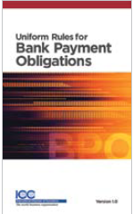
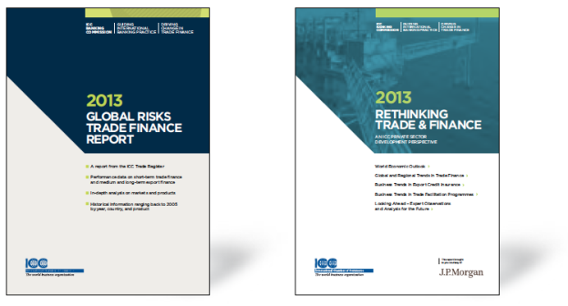





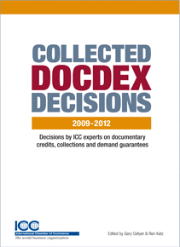
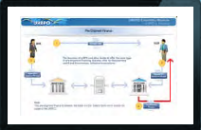
  Our value proposition 2011-2015
1.
STANDARD
SETTING &
RULE WRITING
2.
POLICY
&
REGULATORY
3.
ANALYTICS
&
PUBLICATIONS
Global Surveys
4.
EDUCATION, CERTIFICATION & E-LEARNING
5.
DISPUTE
RESOLUTION
(DOCDEX)

Slide 3



  Partners

Slide 4


2010 – responses from 161 banks
2011 – responses from 210 banks
2012 – responses from 229 banks
2013 – responses from 260 banks
2014 – responses from 298 banks
2015 – responses from 482 banks in 112 countries

Slide 5



slides
The Story Starts September 2008
Growth in world merchandise exports trade by region 2007-2015
(Year to year % change in dollar values)
7/8%
3% ???
5

Slide 6
World Trade Value
Down 15%
World Trade Volume
Down 3%

Slide 7
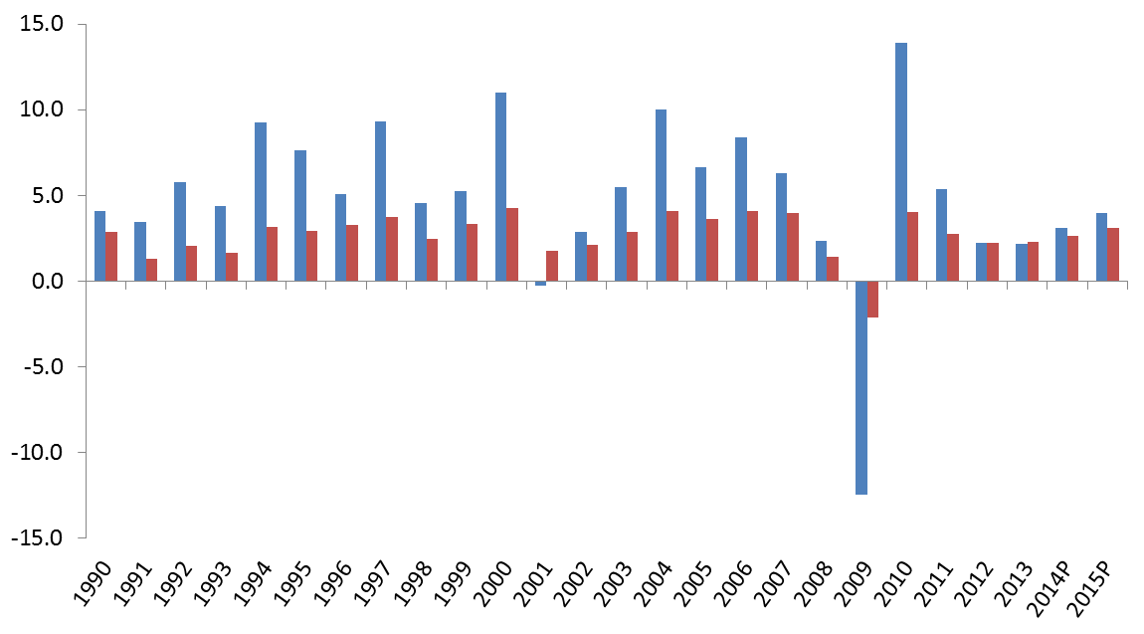
The pull effect is no longer pulling.
World merchandise trade volume and real GDP growth, 1990-2015P
+ 10-year moving average trade/GDP ratio
1.4

Slide 8
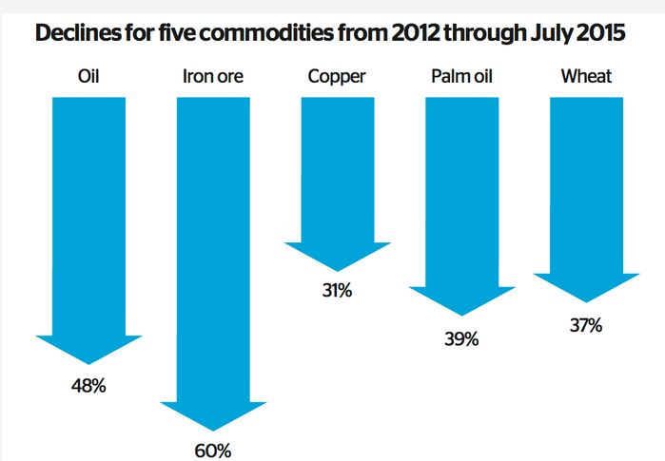
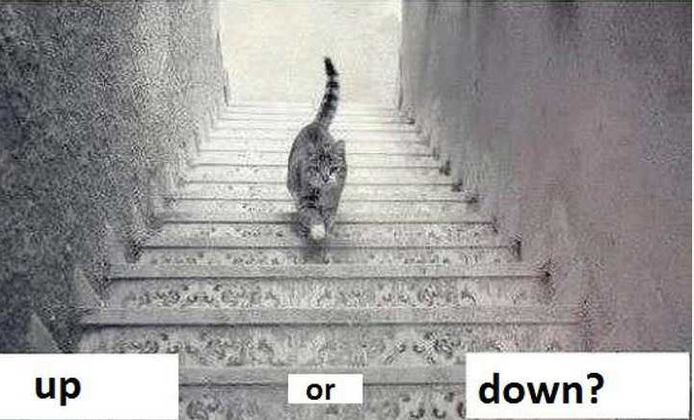
COMMODITIES – UP OR DOWN
….what about…..
commodity prices…..???
…. It has been CAT ...a… strophic !!!!!!
What’s happening in Global Trade Finance and
– what do bankers say ?
- Where is the market ?

Slide 9
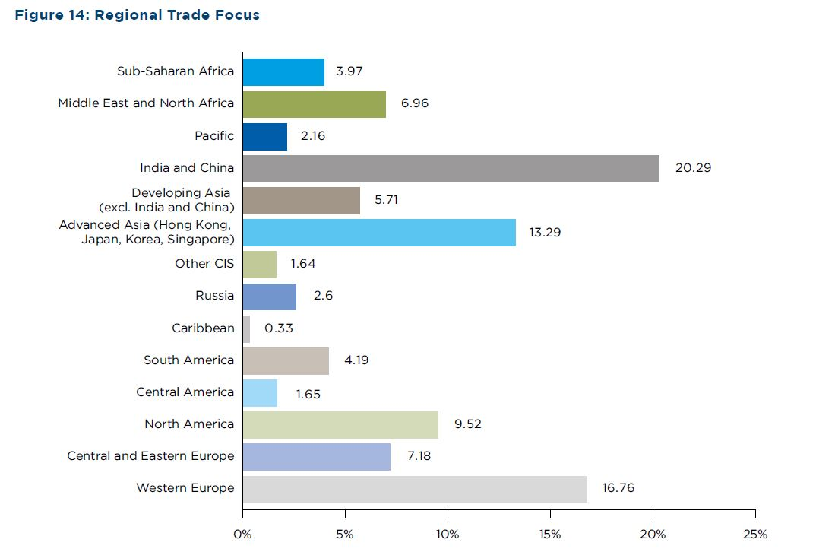
Emerging Asia - Primary Market Focus for Trade Finance
9
39% of trade finance transaction driven by the Asian markets.
39% 37%

Slide 10
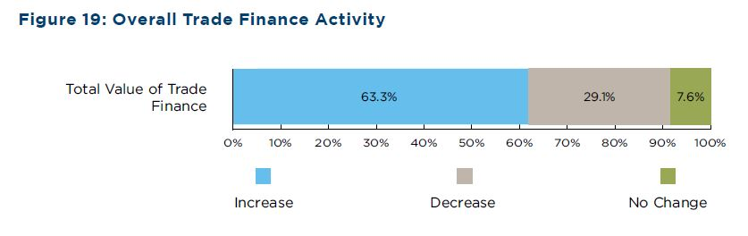
Trade Finance Activity Up or Down ?
10
64% reported increase in trade finance activity.
64% 62%

Slide 11
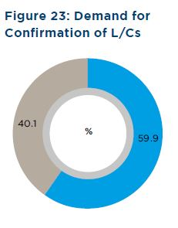
DEMAND FOR CONFIRMATION OF LETTERS OF CREDIT
60% increased demand for
confirmation of Letters of Credit.
60% 53%

Slide 12
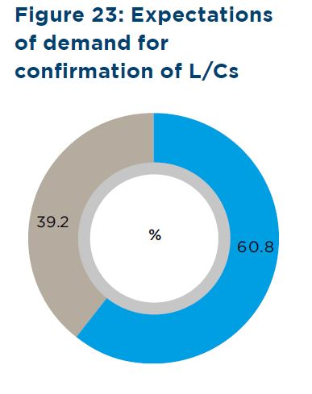
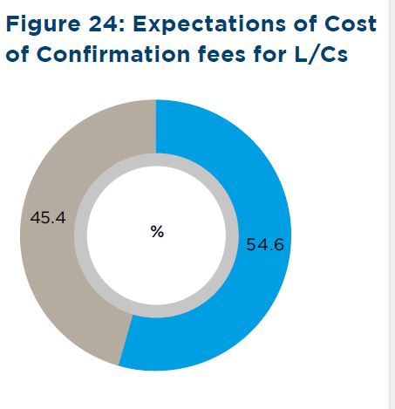
Confirmation Trends going forward 2015
61% expect market demand for confirmations to continue to increase.
55% expect cost of confirmations
to increase going forward .

Slide 13
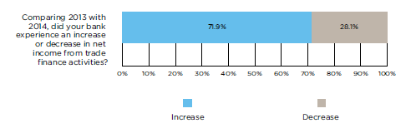
Trends in Trade Finance Fees
72 % expect increase in fees for trade finance risk products

Slide 14
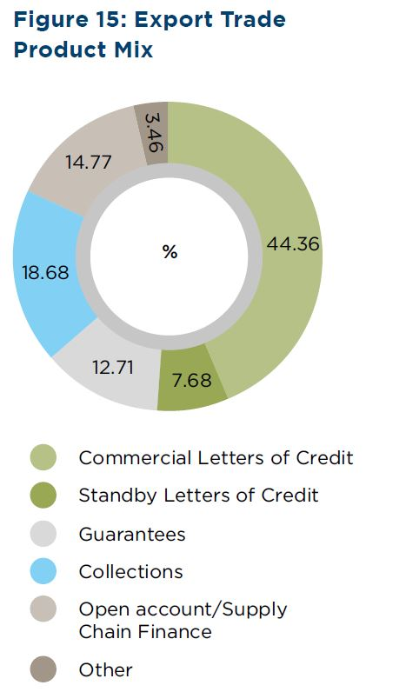
Trade Finance Product Mix
Commercial letters of credit made up 45% Trade Product Mix in the 2015 survey increasing from 41% last year.
Standby Letters of Credit make up
8% of the trade product mix, which is an increase in 2015 from 5% in the 2014 survey.

Slide 15
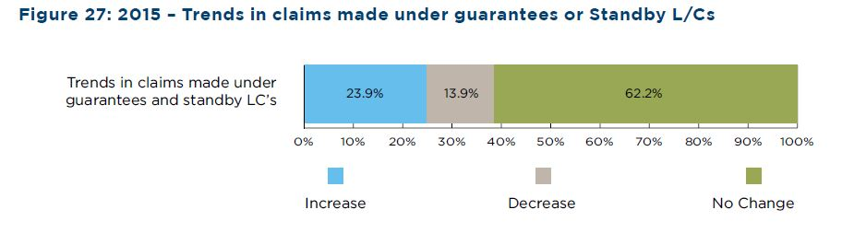
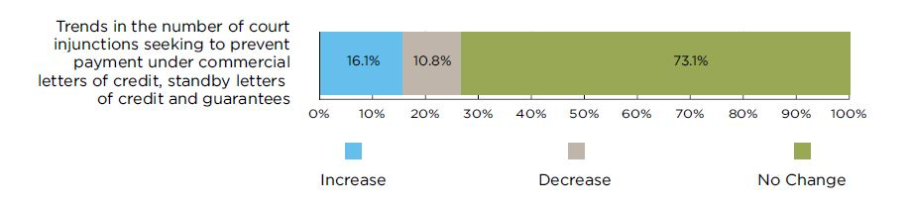
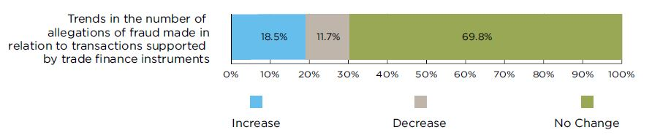
Troublesome Trends – connected!
24 % saw increase in claims under standbys and guarantees.
17 % saw increase in court injunctions.
19 % saw increase in allegations of fraud re bank undertakings undertakings.

Slide 16
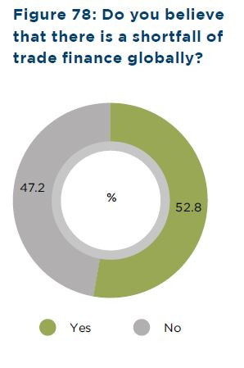

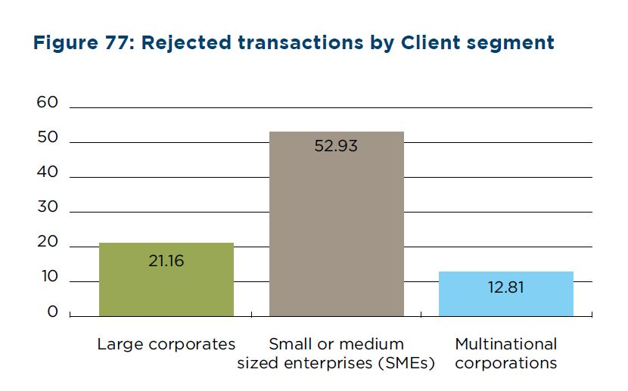

Trade Finance Gap
53% respondents see a shortfall of Trade Finance Globally.
59% of rejected trade finance
Application proposals are
from SMEs

Slide 17
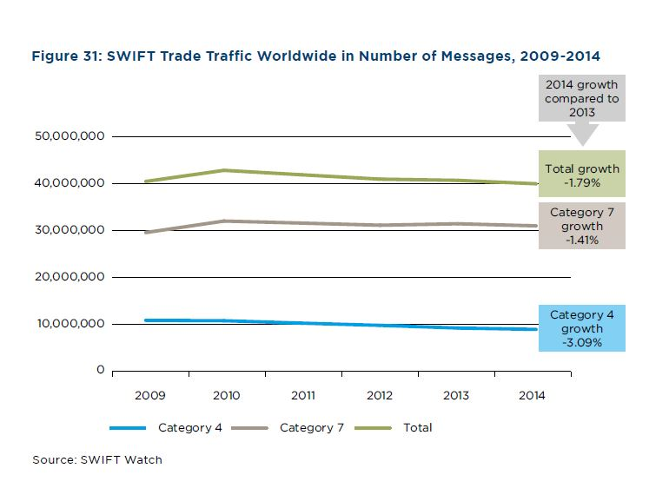
SWIFT Trends in Traditional Trade Instrument Traffic
SWIFT trade down 1.79%

Slide 18
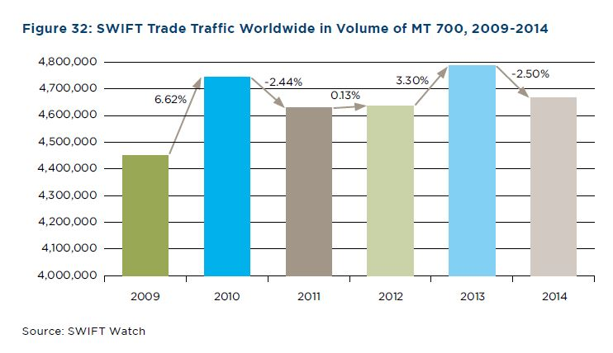
Issuance of letter of credit MT 700
MT 700 DOWN 2.5%

Slide 19
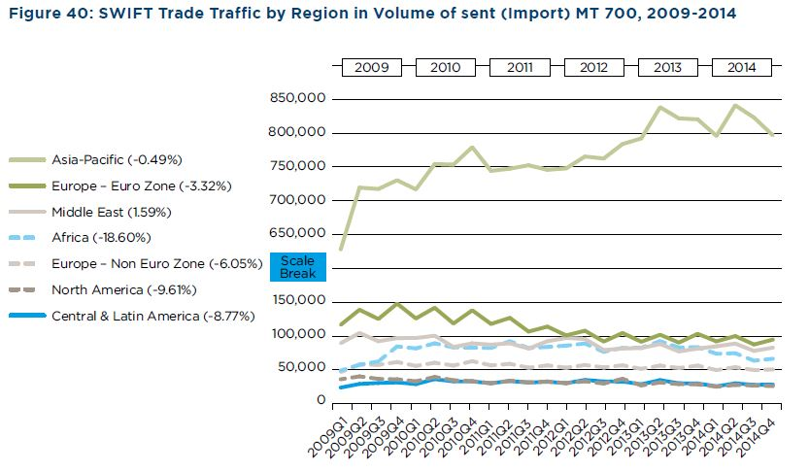
SWIFT Messaging Trends Trade Traffic
70% Import Messaging Trade Traffic originated Asia Pacific

Slide 20
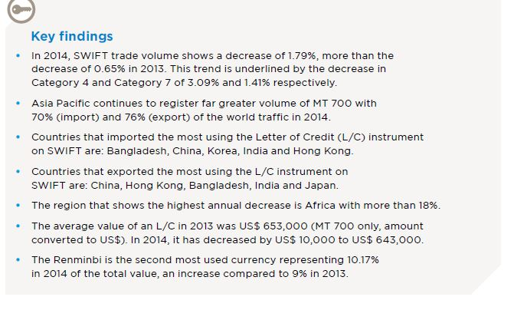
SWIFT trade traffic – key messages END REPORT
The US$ was the currency that represented 80% of the total value of L/Cs issued via SWIFT.

Slide 21
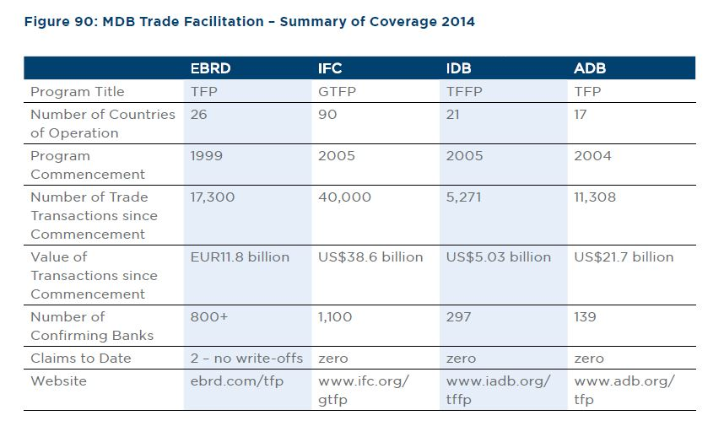

Multilateral Development Banks in Focus 2015
ITFC – more than USD60bn since 2008

Slide 22
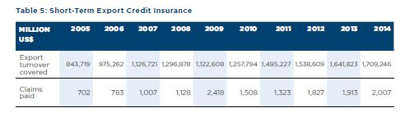
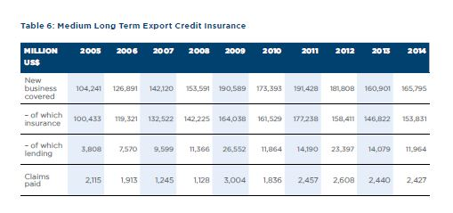
Berne Union – Growth in Export Credit Insurance

Slide 23
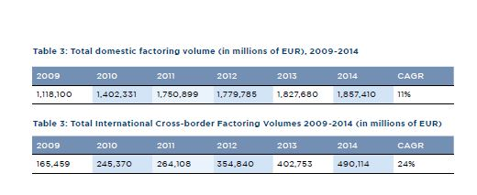
Factoring: Comparison to other forms of Trade Finance
Trends in Factoring – Global Picture
1.6% growth in domestic factoring
22% growth in cross border factoring

Slide 24
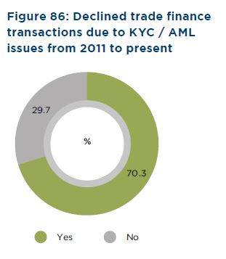

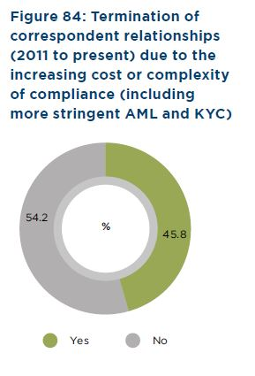
Compliance – KYC - AML
70% declined transactions due to KYC and AML
46% terminated correspondent relations due to KYC and AML

Slide 25
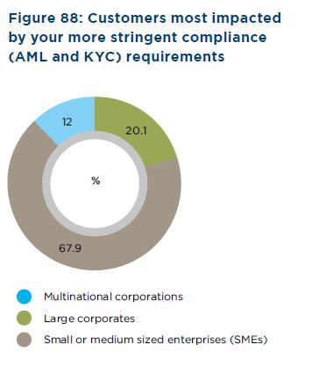
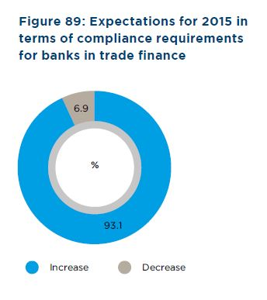
Compliance – KYC - AML
68% customers feeling most negative impact from compliance are SMEs
94% expect compliance to get more restrictive into 2016

Slide 26
On 25 April 2016 in Dubai
Thank you for your valuable time!!!!

